Slide 1

Indoor Air Quality
Group 4

Slide 2
Background
Impact of air pollution
Health – Human and Environmental
PM2.5
Mainly anthropogenic – Car emissions, Smoking
VOC
Produced by common household fumes – Solvents, Aerosols, Disinfectants, Fuels etc.
Notes:
(Sources, background?) for PM2.5 & VOC

Slide 3
Objective
What factors impact indoor air quality?
Outdoor air quality
Household characteristics
Seasonal variations
Forecasting indoor air quality
Notes:
(smoking, number of rooms, distance to A-road, number of occupants)

Slide 4
Methodology
Data Pre-Processing
Exploratory Analysis
Visualisations
Lag correlation
Fourier analysis
Data Modelling
Linear regression
ARIMA
Model Results & Comparison

Slide 5
Data Pre-processing
Survey Data containing all households
Smoking, Household size, No of rooms, Property type, Dist. to road, Fuel poverty indicator
Air Quality Data (Csv files per household)
Indoor PM2.5 & VOC – Data ~5 mins
External PM2.5 & VOC – Data ~30 mins for 46 households
Resampled for every hour
Filtering households
Merged all data into single data-frame using Python

Slide 6
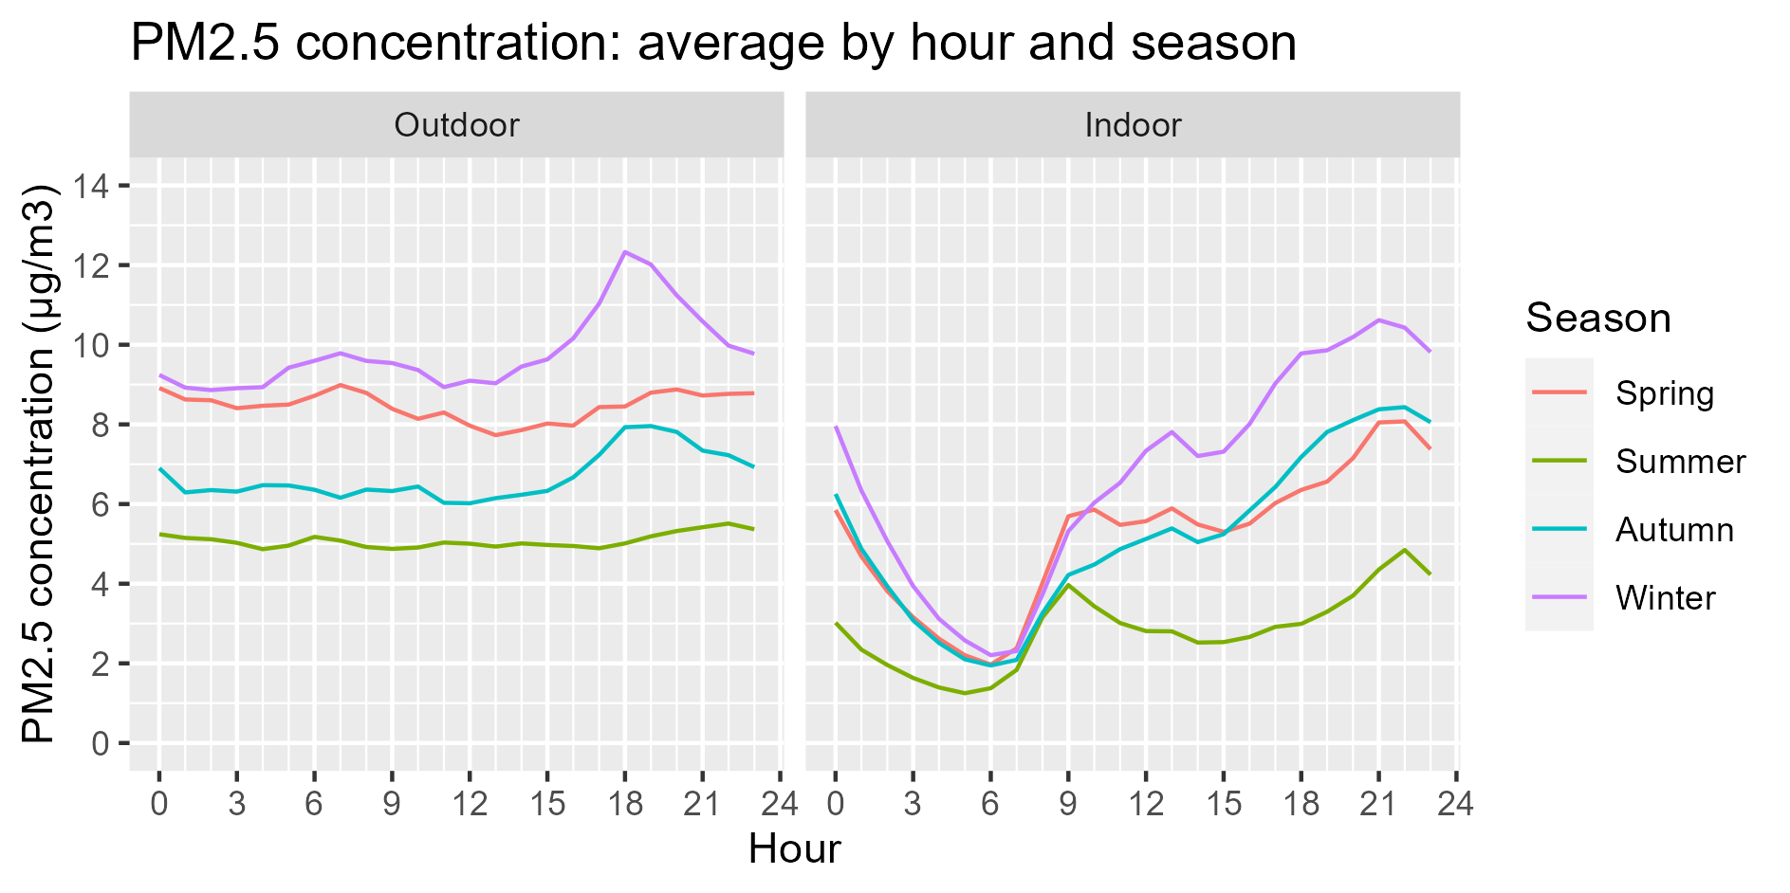
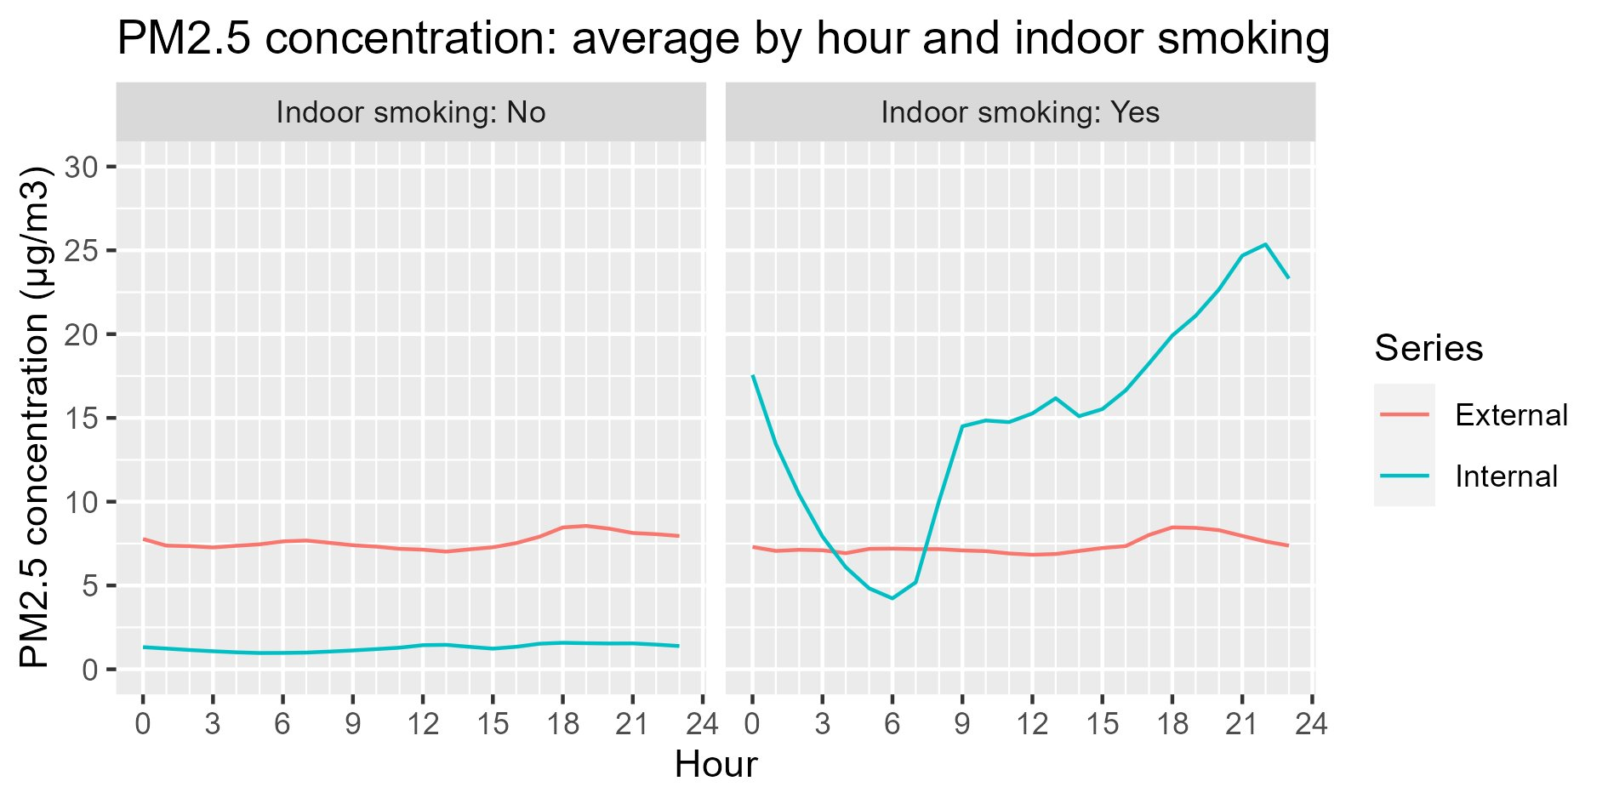
Data visualisation: daily profiles
Seasonal Variations
Impact of Smoking
Notes:
PM2.5 concentrations are higher in winter
Cold air moves more slowly, leading to slower diffusion of particulates

Slide 7
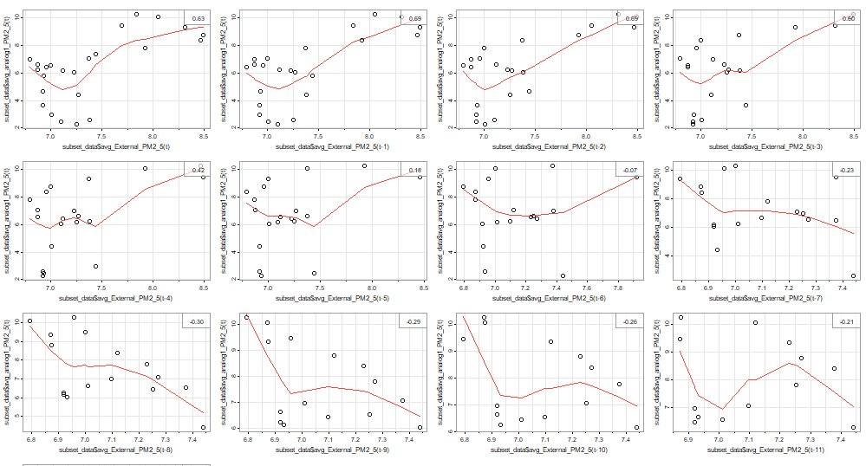
Lag correlation
Which lag gives the highest correlation?
Scatterplot of External vs Indoor PM2.5 concentrations, showing correlations at different External hourly time lags
0.63
0.69
0.68
0.60
t
t - 1
t - 2
t - 3
0.42
0.07
-0.18
-0.23
Indoor PM2.5
t - 4
t - 5
t - 6
t - 7
-0.30
-0.29
-0.26
-0.21
t - 8
t - 9
t - 10
t - 11
Lagged External PM2.5 (t=hour)
Notes:
Compare the external and indoor time-series, and see when they best match-up – how much do you have adjust the time lag on one to get the best correlation
So these scatterplots demonstrate the correlations between external and indoor PM2.5 data as you lag the external data by hour. This shows the strongest correlation at about 1 hour

Slide 8
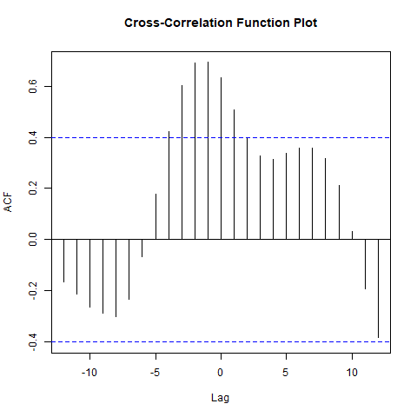
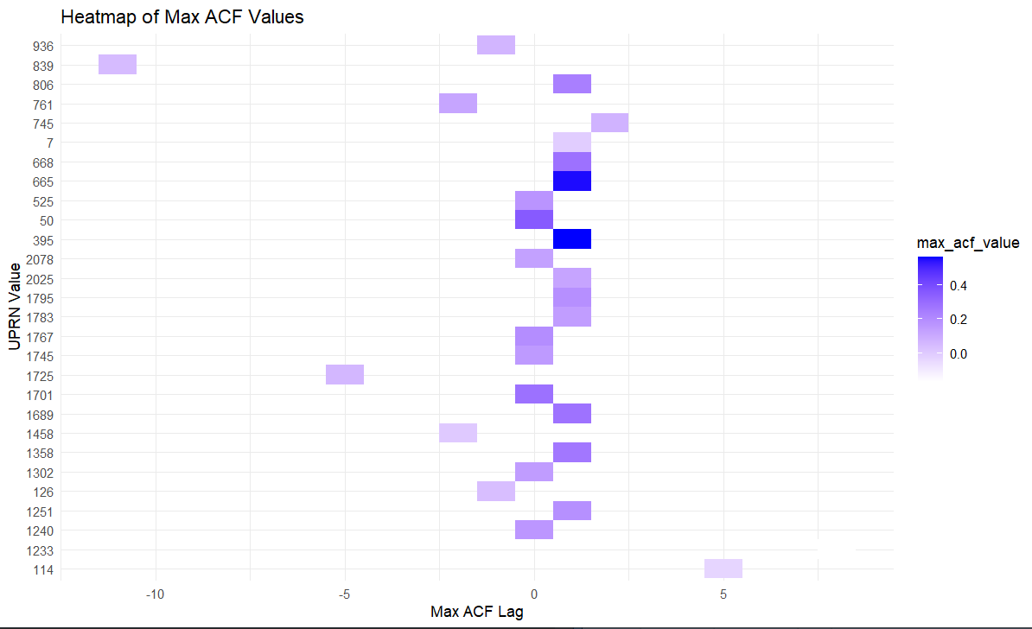
Lag correlation
PM2.5 result: Some general evidence of a one-hour lag
Averaged time across 24 hours
Optimum Correlation and Lag for each Household
(Autocorrelation Function)
Max ACF value
UPRN
-10 5 0 5 10
Optimum lag (hour)
External PM2.5 lag (hourly)
Notes:
I arranged and averaged the data in a few different ways, and they all showed a general positive correlation and lag of around one hour. This example, averaging just across a 24 hour time period gave the strongest overall correlation. This follows what we expected and the literature, where most sources state around an hour.
When looking at individual properties, most tended around 0 and –1, with a few odd results, which highlighted the issue with grouping the data by hour when the original data was finer than that – it gave a rough result that there was a lag

Slide 9
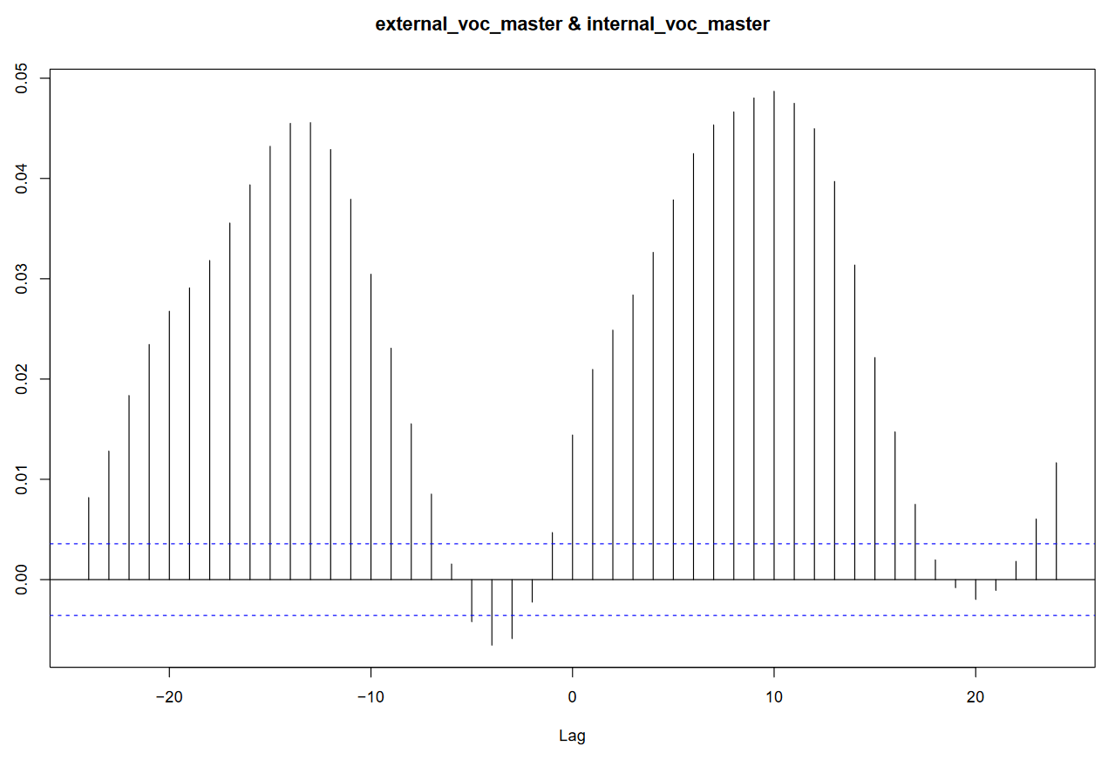
Lag correlation
VOC result: No appreciable lag found
External vs Internal VOC correlations
Low correlation
24-hour cycle
Autocorrelation Function
Lag (hour)
Notes:
Similarly, I did the same process with the VOCs and the results were all over the place, but this graph shows there is a 24 hour cycle, but with very low correlation, no appreciable VOC lag.

Slide 10
Fourier Analysis
Visualising a signal as its parts.
Identifying strongest contributors to cyclical patters.
Any time series data with regular intervals and potential cycles.

Slide 11
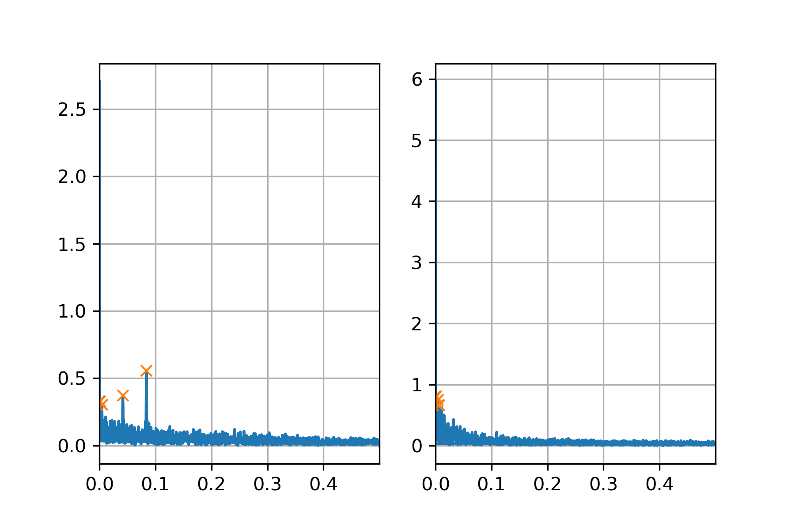
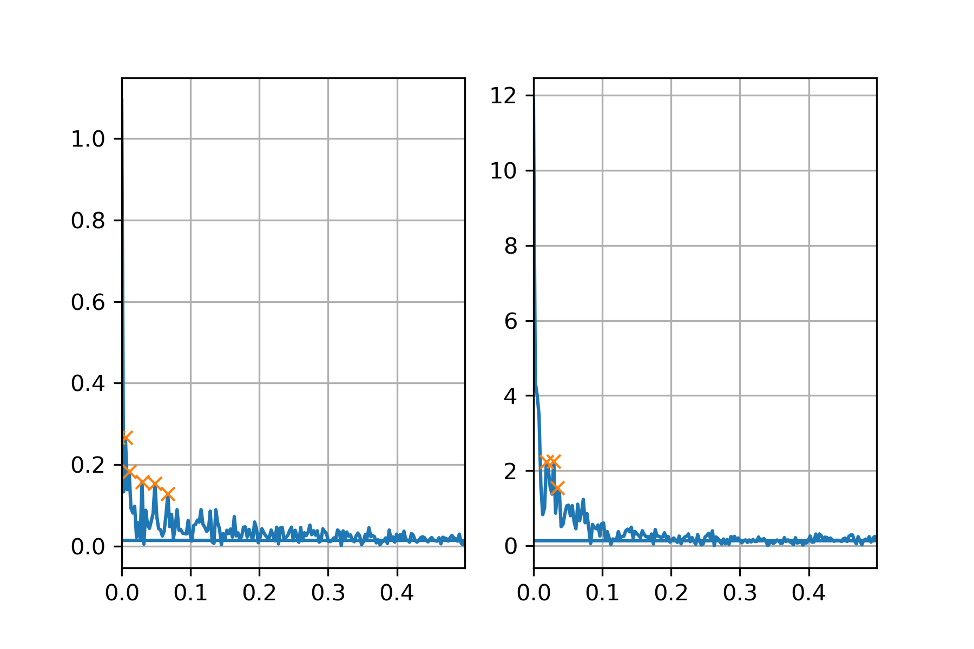
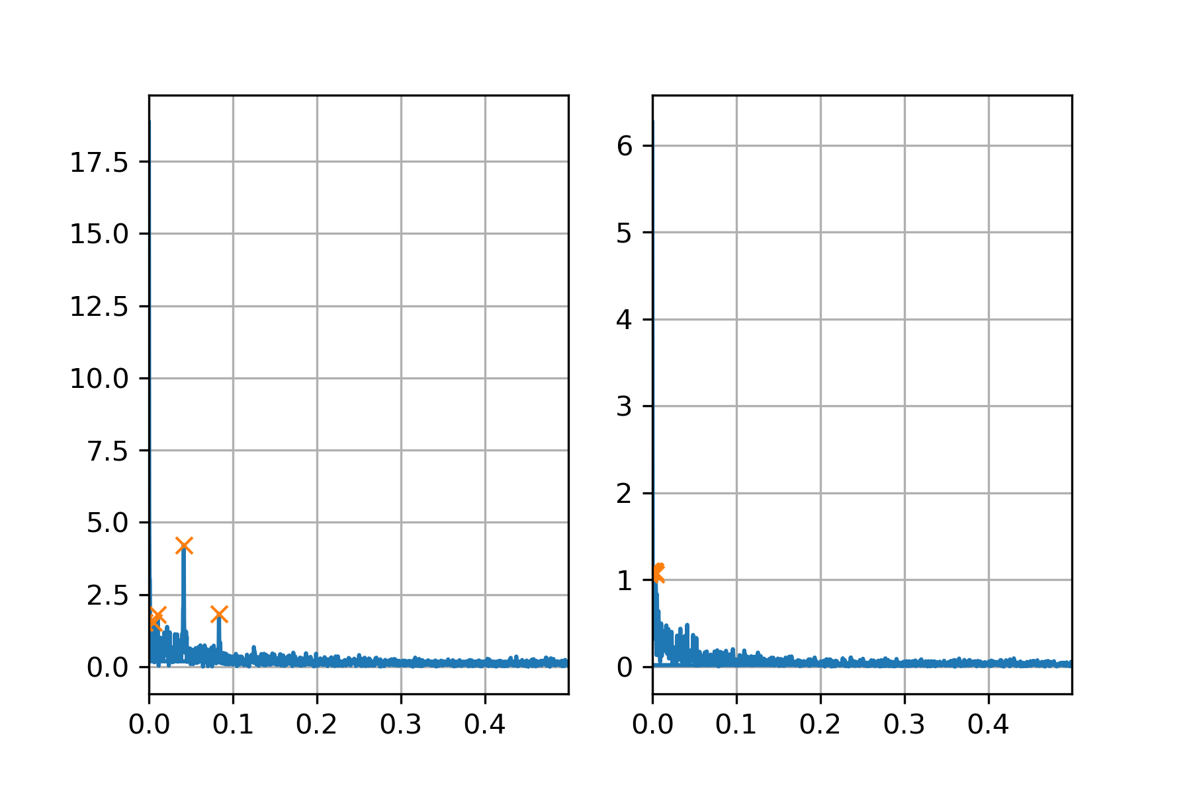
Fourier Analysis
Green ~= 12 Hour Cycle
Blue ~= Daily Cycle
Yellow = Shared Cycles
UPRN – 7 (3685 Samples)
Frequency | Amplitude
Internal: External:
0.0011|0.2662 0.0011|0.8127
0.0043|0.1832 0.0295|0.7504
0.0418|0.1579 0.0052|0.6629
0.0839|0.1532
1/0.0011 = 909.0909
909.0909/24 = 37.8788 Days.
UPRN – 395 (373 Samples)
Internal: External:
0.0054|0.2662 0.0188|2.2323
0.0107|0.1832 0.0295|2.2428
0.0295|0.1579 0.0349|1.5405
0.0483|0.1532
1/0.0295 = 33.8983
33.8983/24 = 1.4124 Days.
UPRN – 1689 (2576 Samples)
Internal: External:
0.0058|1.5270 0.0016|1.1041
0.0105|1.8001 0.0031|1.0957
0.0415|4.2155 0.0039|1.0647
0.0835|1.8369
No shared cycles.
Strong daily cycle:
1/0.0415 = 24.096 Hours.
1/0.0835 = 12 hours

Slide 12
Linear regression
Indoor concentration = outdoor concentration + other factors
Fitted separate models for PM2.5 and VOC
Assumed no lag between outdoor and indoor
Log transformation to reduce positive skew

Slide 13
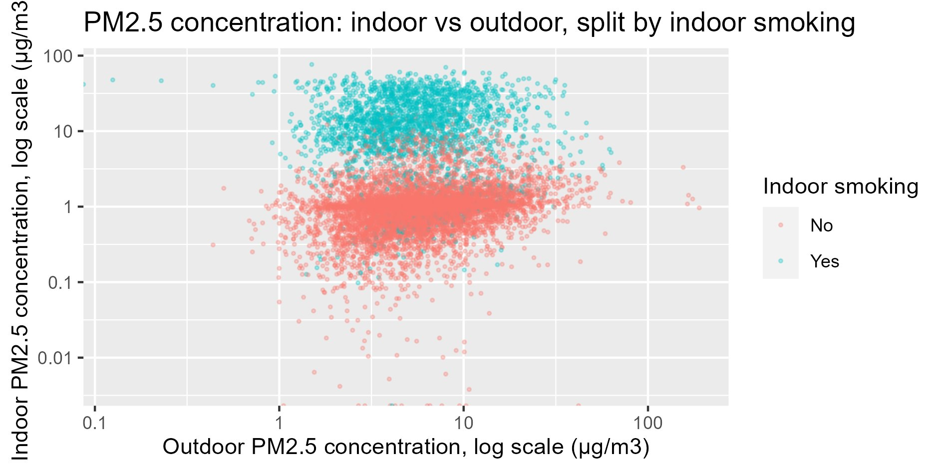
Linear regression: PM2.5
Explanatory variable | Effect on indoor PM2.5 concentration (response variable)
Outdoor PM2.5 | Non-smoking homes: Doubling in outdoor PM2.5 associated with 10% increase in indoor PM2.5 Smoking homes: Negligible effect
Indoor smoking | 9x higher for smoking homes vs. non-smoking homes
Fuel poverty | 22% higher in fuel poor homes
Property size | 12% higher in smaller homes (5 or fewer rooms) than larger homes (6 or more rooms)
Distance to A-road | 3% higher for every 100m nearer to A-road
Adjusted R^2 = 76% p-values: < 0.001 for all variables
Notes:
Outdoor PM2.5: has a different effect for smoking and non-smoking homes.
Fuel poverty: linked to ventilation habits – fuel poor homes open windows less frequently to save on heating
Property size: linked to ventilation

Slide 14
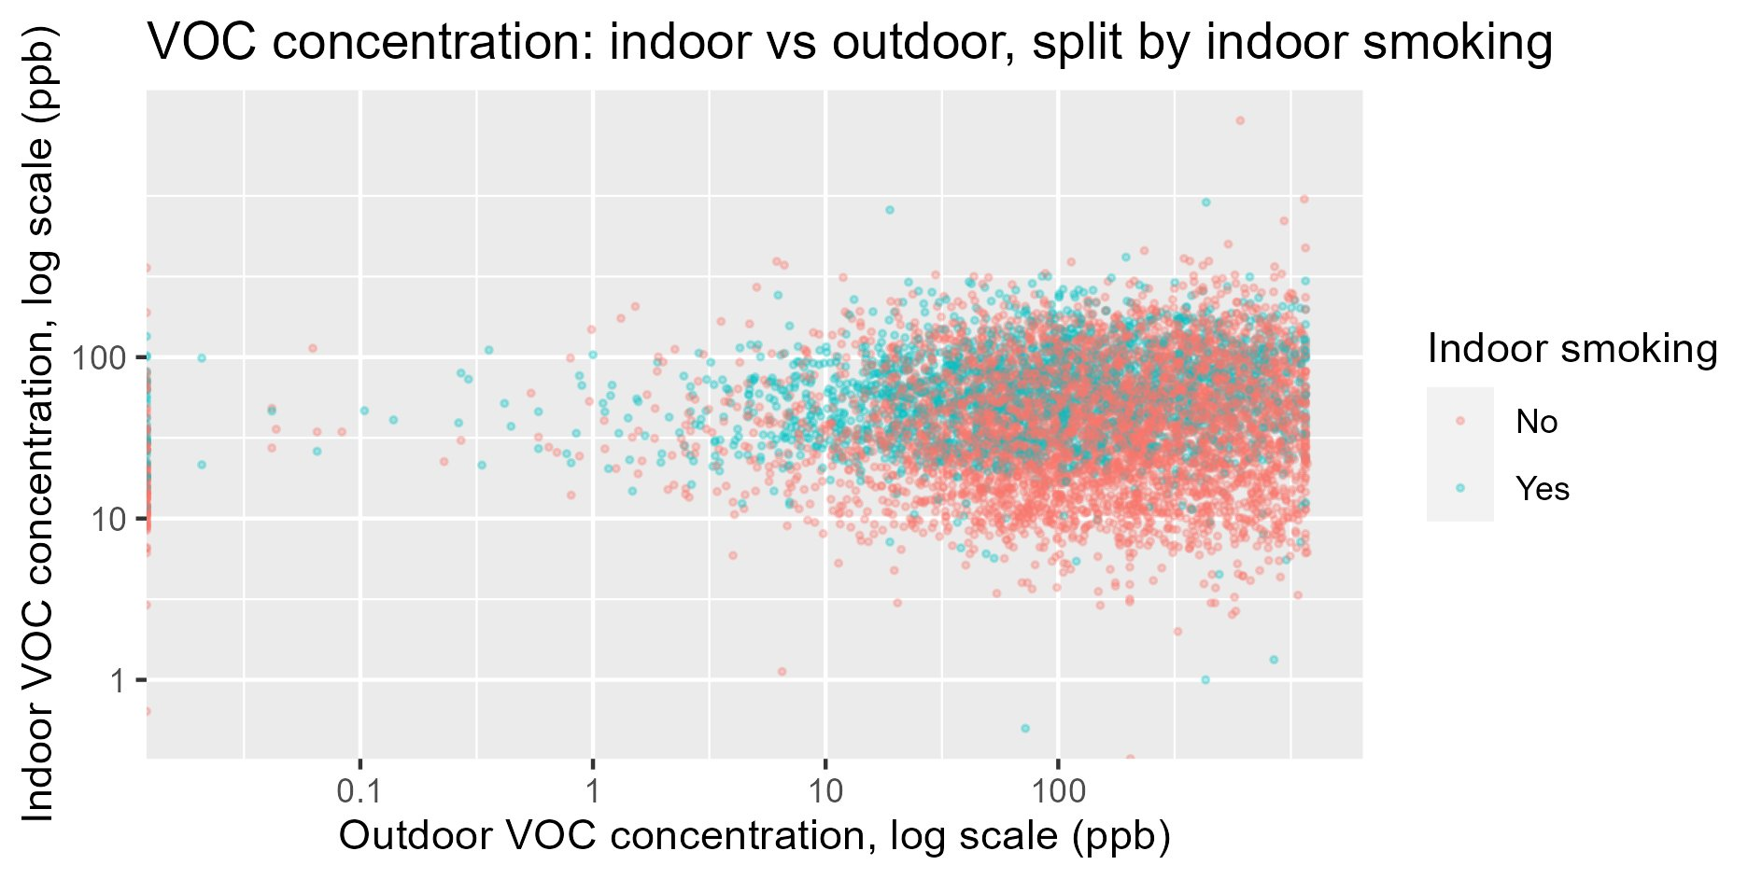
Linear regression: VOC
Outdoor VOC concentration has negligible effect on indoor VOC concentration
Weak impact of indoor smoking
Notes:
Linear model could only explain 8% of total variance in indoor VOC

Slide 15
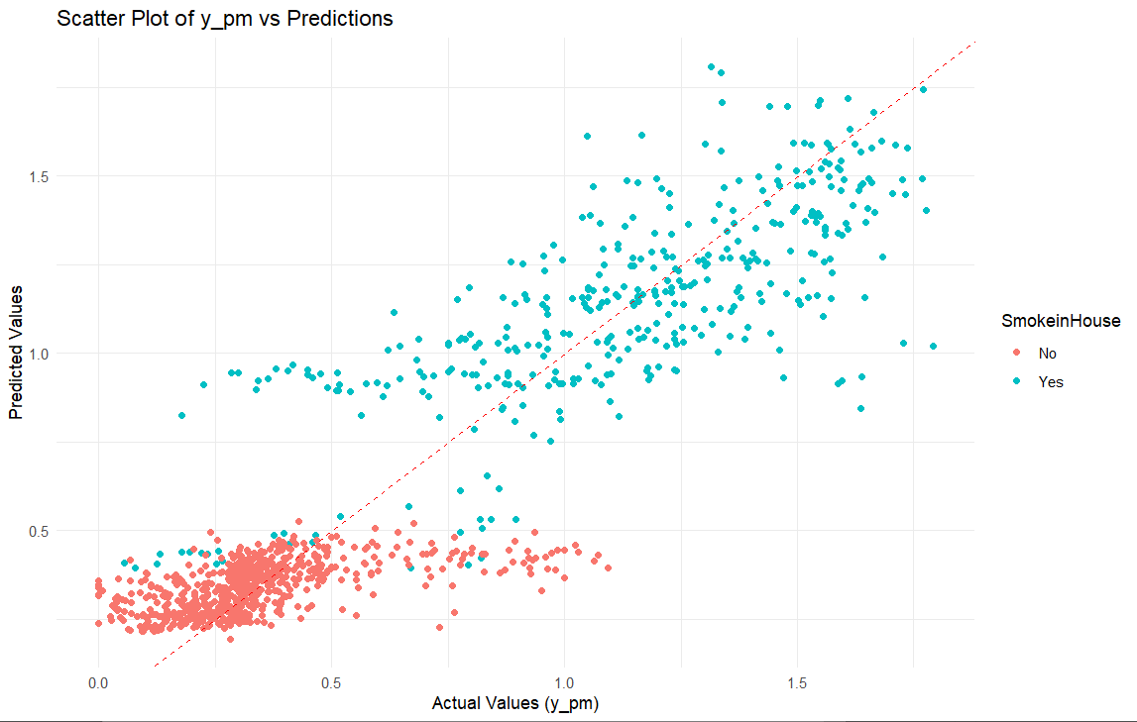
Linear regression: PM2.5 predictions
Scatterplot of Actual Values vs Predicted Values using LR Model
Data split into:
80% for training
20% for testing
Notes:
Once we had chosen the optimum model, we did a bit of testing. I randomly split up the data 80/20, produced the model again with the training data and made predictions against the test data.
The scatterplot compares the actual PM2.5 values in the test data with the model predictions. A one-to-one relationship would be a perfect model, whereas we can see a fair amount of variance, particularly in non-smokers.

Slide 16
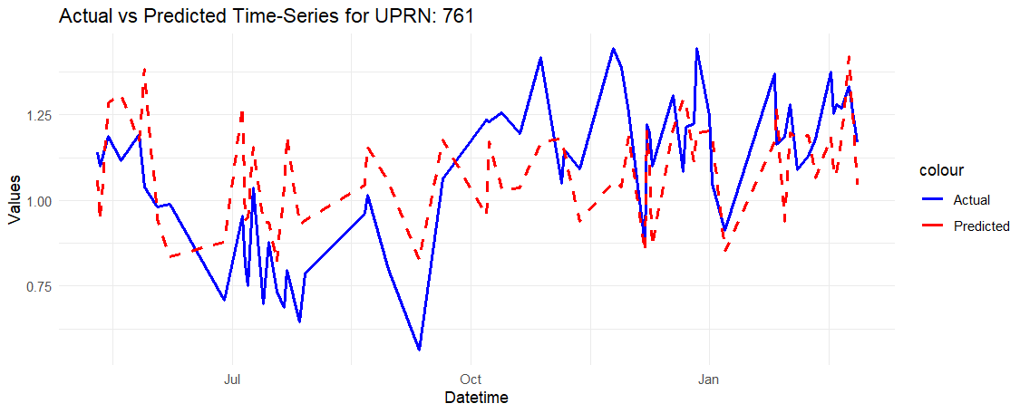
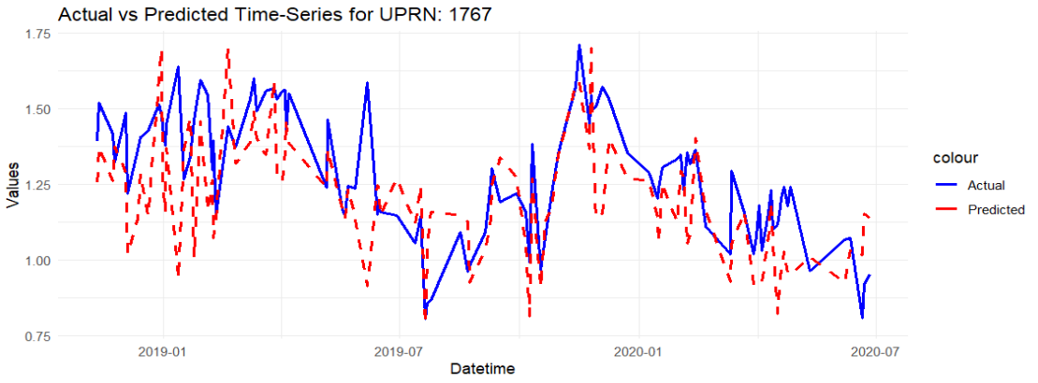
Linear regression: PM2.5 predictions
R-squared of the model:
0.76
R-squared based on predicted values:
0.72
Notes:
Found that R2 of predicted values was slightly less but similar to the original which suggests that the model generalises quite well. Which you can see here when looking at the actual vs predicted values for individual properties.
The model gives a general pattern.

Slide 17
ARIMA Model
Predict future indoor PM2.5 given past values in time series
Works when data is stationary
No seasonality
Constant mean and variance
Achieved stationarity via differencing by 1
PM2.5(t) = PM2.5(t) - PM2.5(t-1)
Dickey-Fuller test
Choosing hyperparameters (p, d, q) using ACF and PACF plots

Slide 18
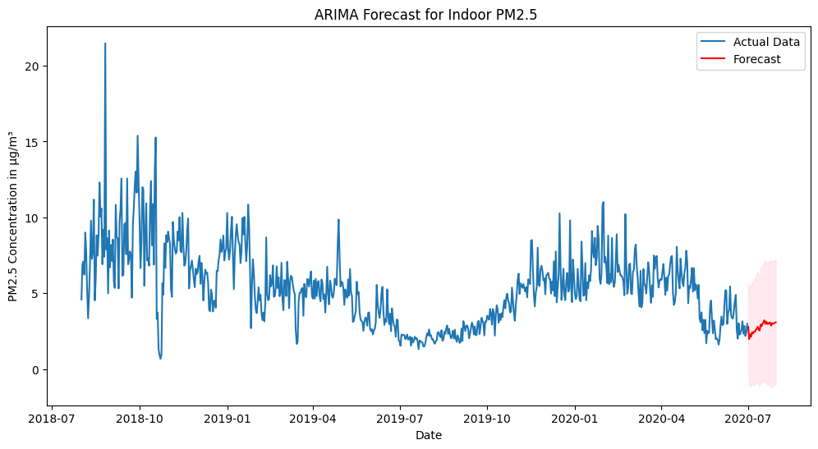
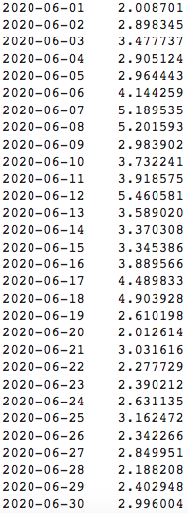
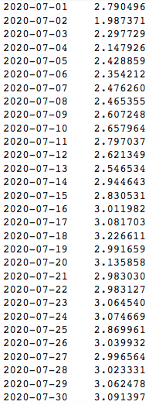
ARIMA Model
Actual Values
Forecasted Values

Slide 19

ARIMA Model Performance
Naïve Model as Baseline – PM2.5(t+1) = PM2.5(t)
ARIMA Model
ARIMA Model outperforms in all above metrics

Slide 20
Conclusions
Indoor smoking is the most important driver of indoor PM2.5 for smoking homes
Outdoor PM2.5 has a weak impact on indoor PM2.5
Negligible impact for smoking homes
<1 hour lag between outdoor and indoor
Outdoor VOC has no significant impact on indoor VOC
PM2.5 concentration highest in winter, indicating seasonal variations
Data models promising in predicting future PM2.5 concentration

Slide 21
Appendix

Slide 22
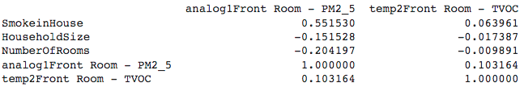
Spearman Correlations

Slide 23
Correlation
Pearson Vs Spearman Correlation

Slide 24
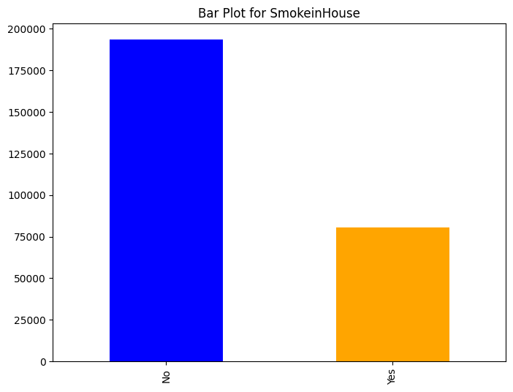

Slide 25
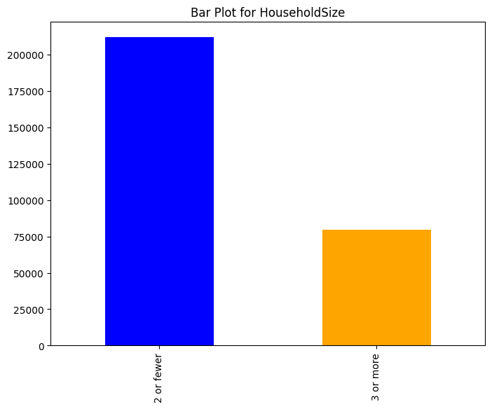

Slide 26
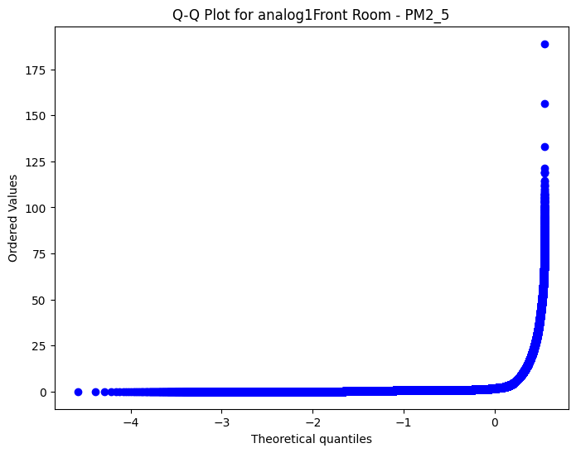

Slide 27
Correlations Results
Indoor PM2.5
Strong positive correlation with smoke in house (0.58)
Negative Correlation with 'HouseholdSize' (-0.21) and 'NumberOfRooms' (-0.33)
Positive Correlation with 'External PM2.5' (0.10)
The p-values being close to zero indicate that the observed correlations are statistically significant.

Slide 28
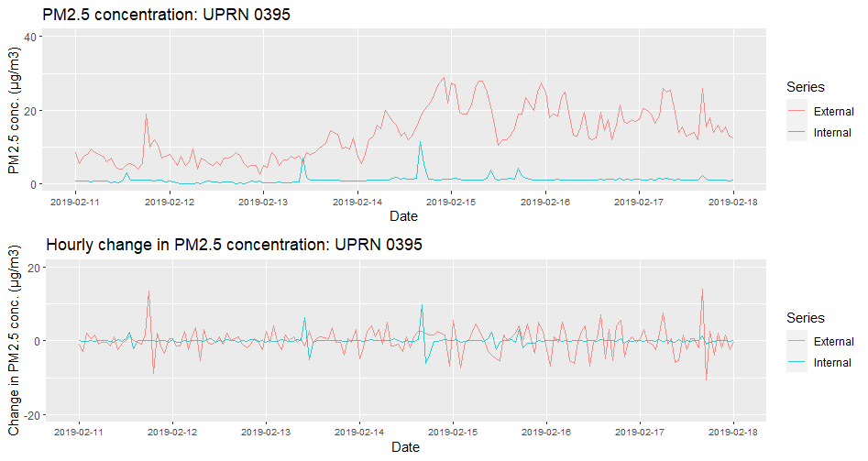
PM2.5: Typical non-smoking household
Notes:
What does a typical PM2.5 time series look like for a household that doesn’t smoke indoors?
External is typically higher than internal
No obvious correlation between indoor and outdoor from this week
1 & 2: Small indoor peaks without corresponding outdoor peaks. Possibly cooking or gas usage?
3: Possible influence of outdoor on indoor? If so, very subtle!

Slide 29
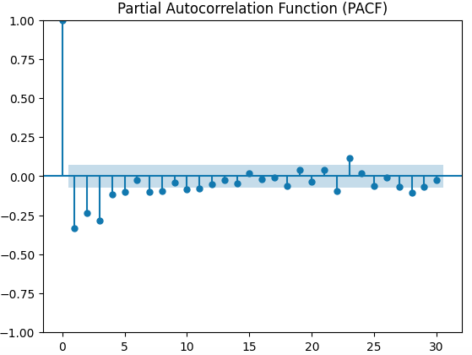
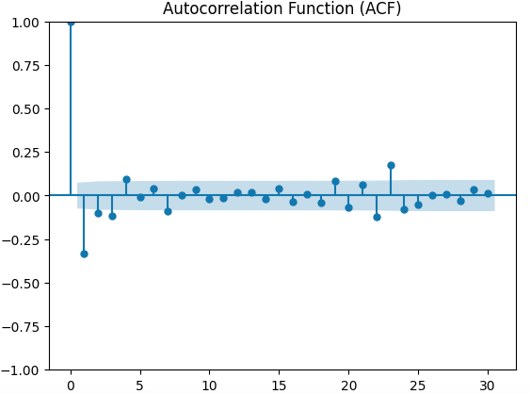
Hyperparameters in ARIMA
P = No. of lagged values
D = degree of differencing
Q = No. of moving average terms
PACF = Auto-correlations, minus intermediate observations
ACF = Auto correlations with lagged values

Slide 30
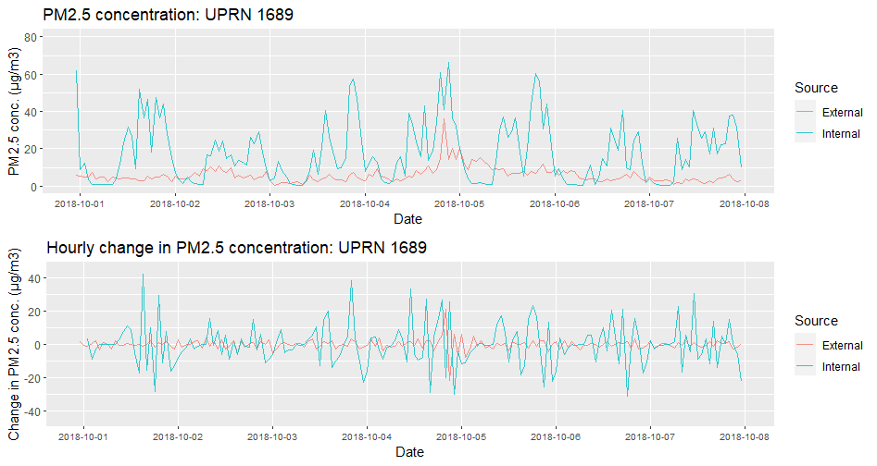
PM2.5: Typical smoking household
Notes:
What does a typical PM2.5 time series look like for a household that smokes indoors?
Internal is typically higher than external
Left: clear peaks indicating rising PM2.5
Right: Possible influence of outdoor?

Slide 31
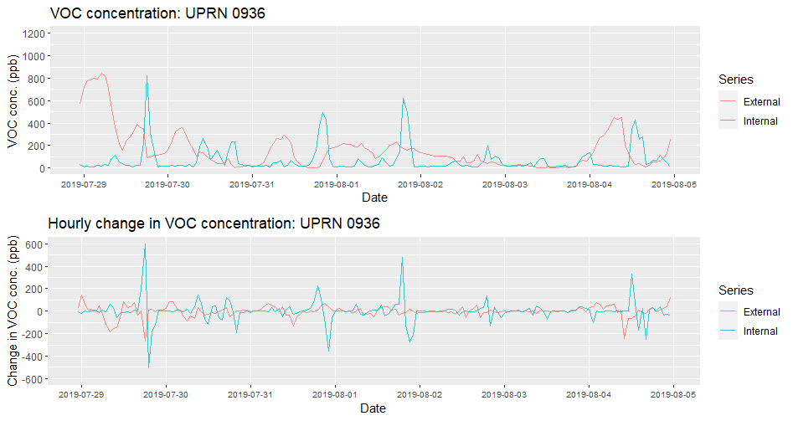
VOC: Typical non-smoking household
Notes:
Indoor still sees big peaks even if not smoking
Consistent with VOC being mainly from indoor sources

Slide 32
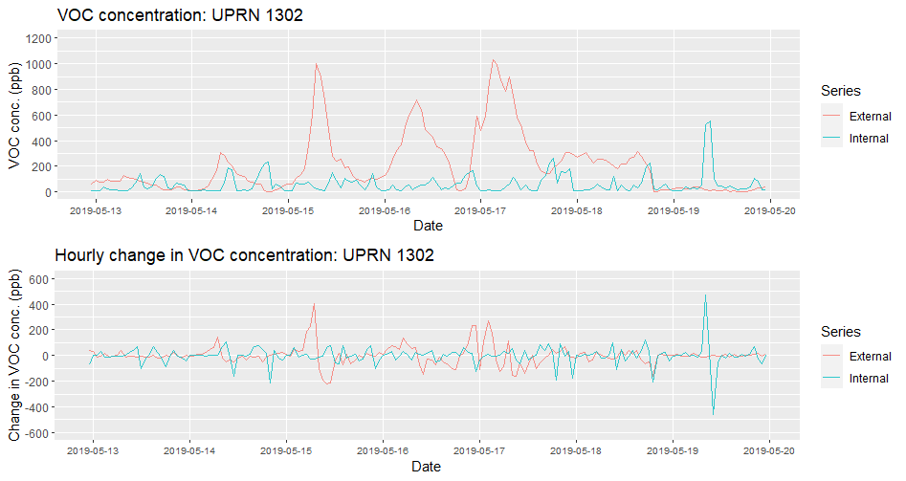
VOC: Typical smoking household
Notes:
No clear difference with non-smoking impact
We know smoking leads to higher VOC but looks like in a more subtle way than for PM2.5

Slide 33
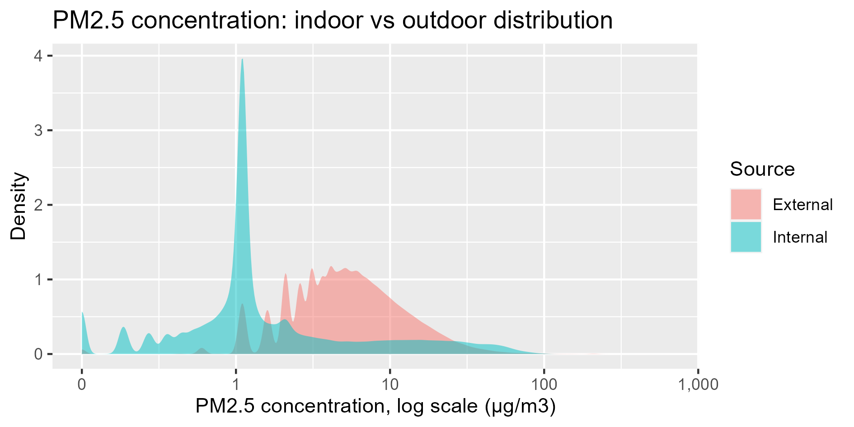
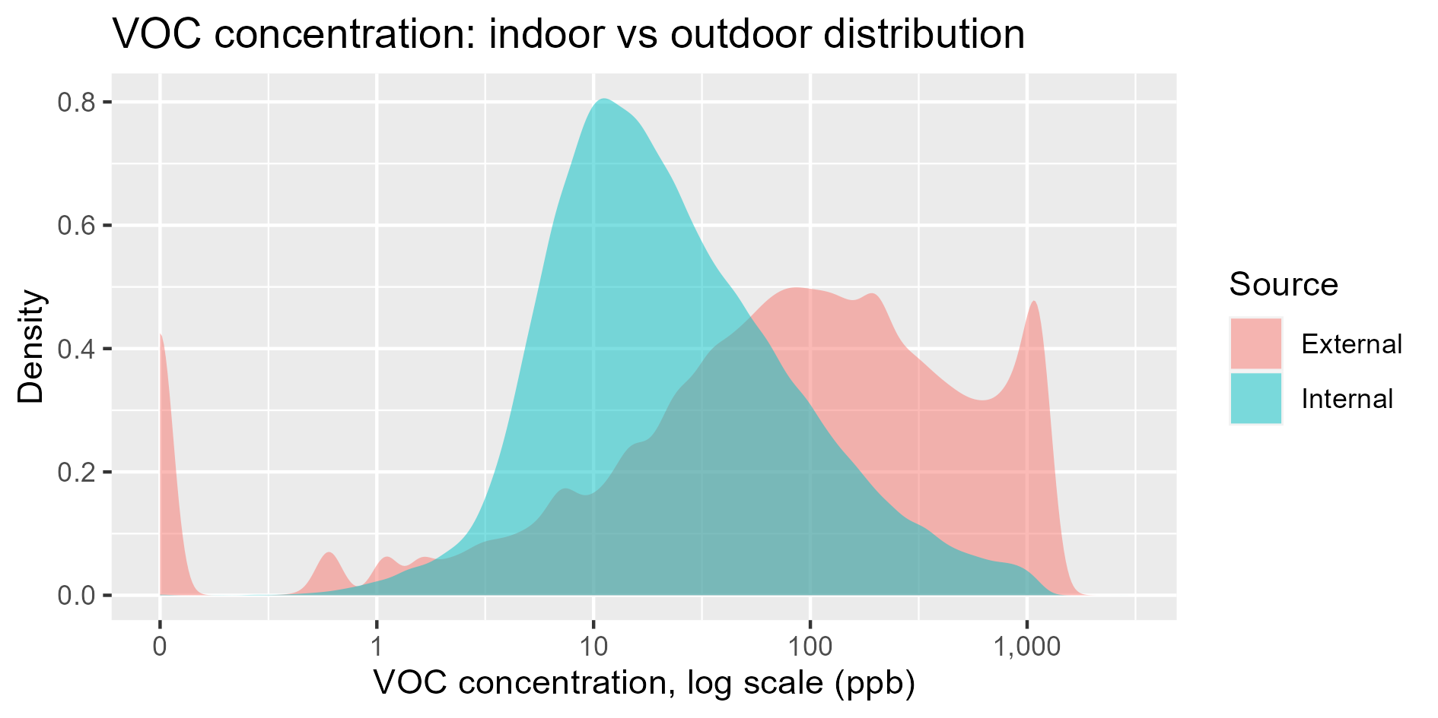
Indoor vs outdoor distributions
Notes:
Left: PM.5 shows peaks at concentrations between 1 and 10 due to rounding of sensor readings
Right: VOC sensors are capped at 1200 ppb

Slide 34
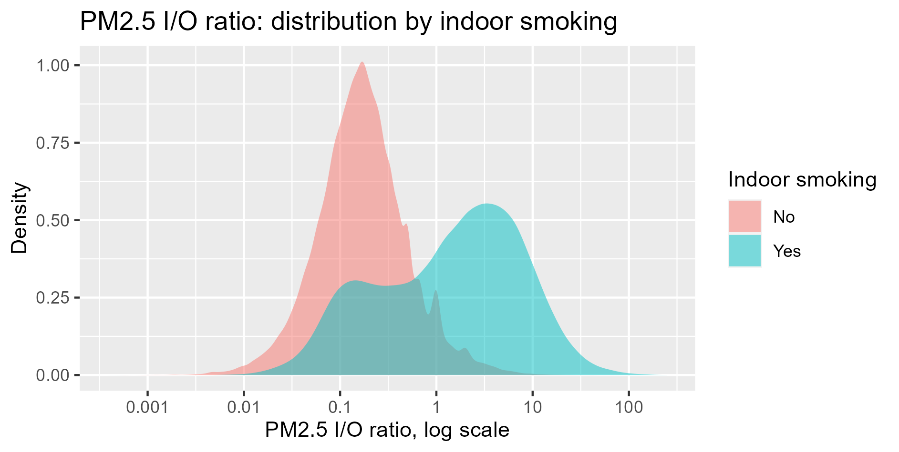
Impact of indoor smoking: PM2.5
Notes:
Left: indoor to outdoor ratios
I/O = Indoor/outdoor ratio (referenced in Liu et al paper as a measure of relationship between indoor and outdoor concentrations)
If I/O > 1, indoor concentration will be dominated by outdoor sources
If I/O < 1, indoor concentration will be dominated by indoor sources
Smoking leads to higher PM2.5 concentrations
Bimodal distribution – potentially for smoking time and non-smoking time
Right: Average daily PM2.5 profile by hour across all properties, split by smoking/non-smoking
Smokers: PM2.5 starts to rise in the morning, builds up during the day, then falls at night (though doesn’t quite reach non-smoking levels)
External similar for smokers/non-smokers

Slide 35
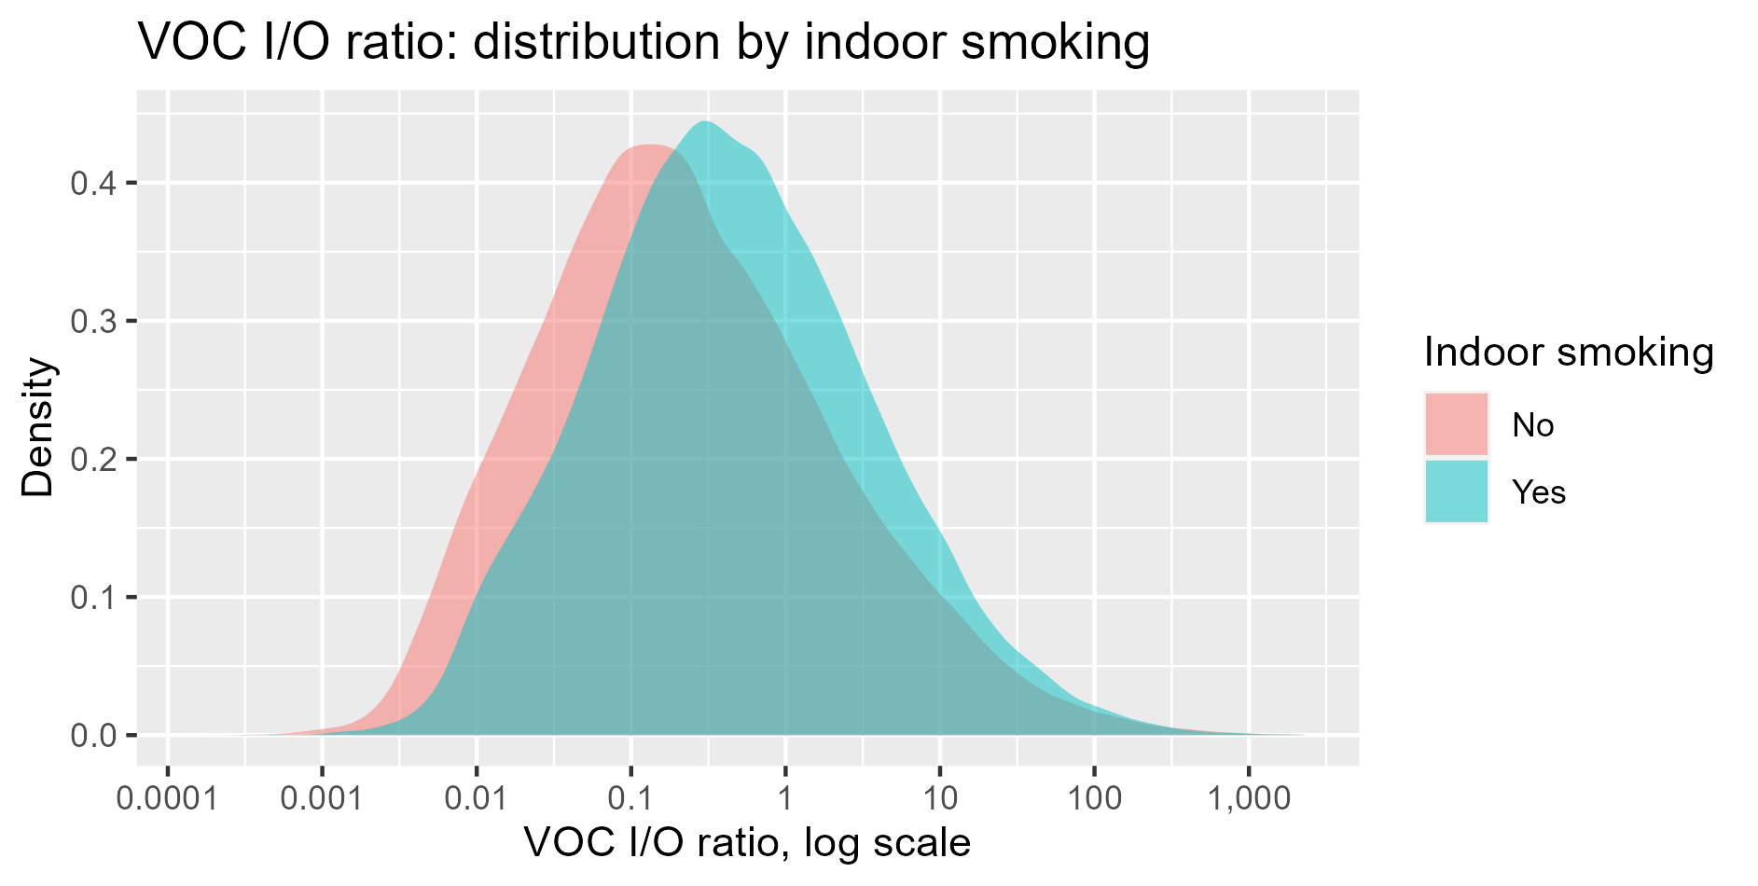
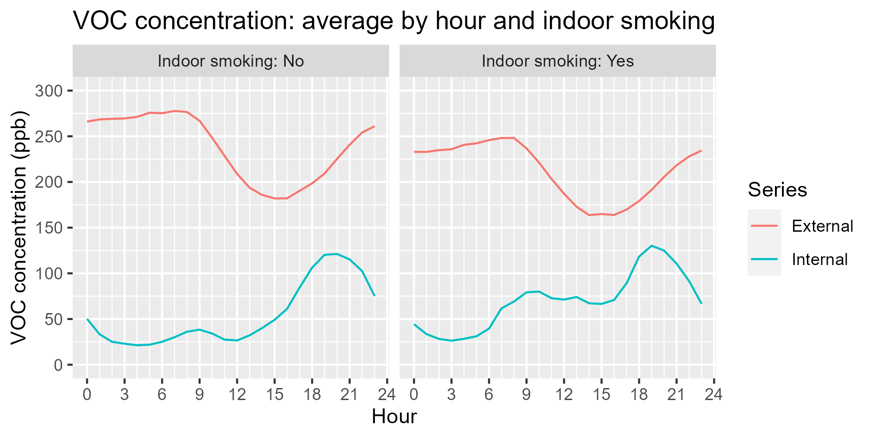
Impact of indoor smoking: VOC
Notes:
Right: Average daily PM2.5 profile by hour across all properties, split by smoking/non-smoking
Smokers: PM2.5 starts to rise in the morning, builds up during the day, then falls at night (though doesn’t quite reach non-smoking levels)
External similar for smokers/non-smokers

Slide 36
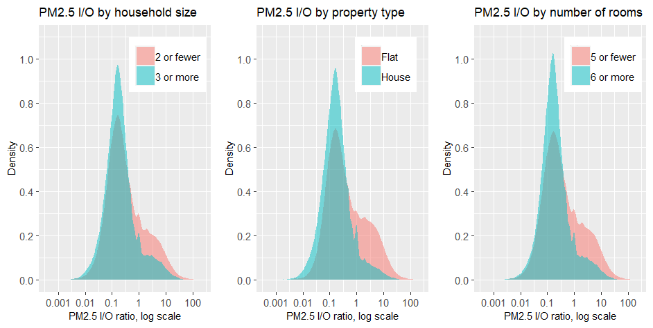
Impact of property size: PM2.5
Notes:
Indoor to outdoor ratios
These factors are all proxies for house area – all proxies show similar results
Smaller properties have higher PM2.5 concentrations
No clear impact of property size on VOC

Slide 37
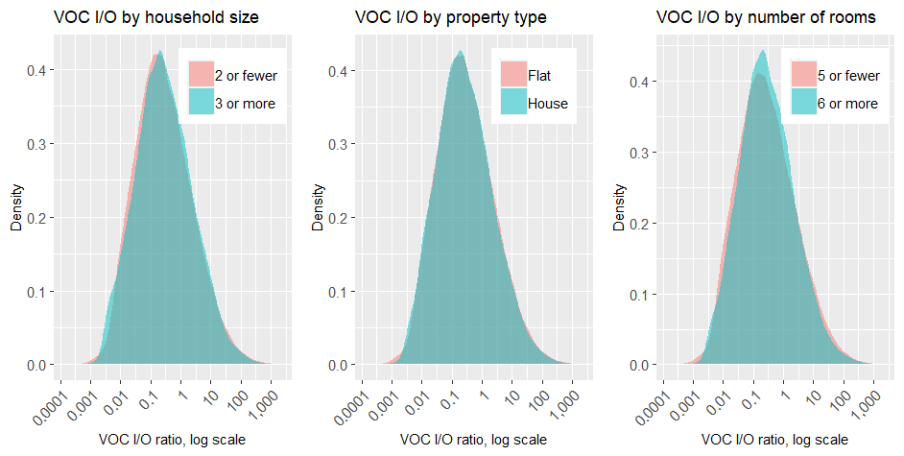
Impact of property size: VOC
Notes:
Indoor to outdoor ratios
These factors are all proxies for house area – all proxies show similar results
Smaller properties have higher PM2.5 concentrations
No clear impact of property size on VOC

Slide 38
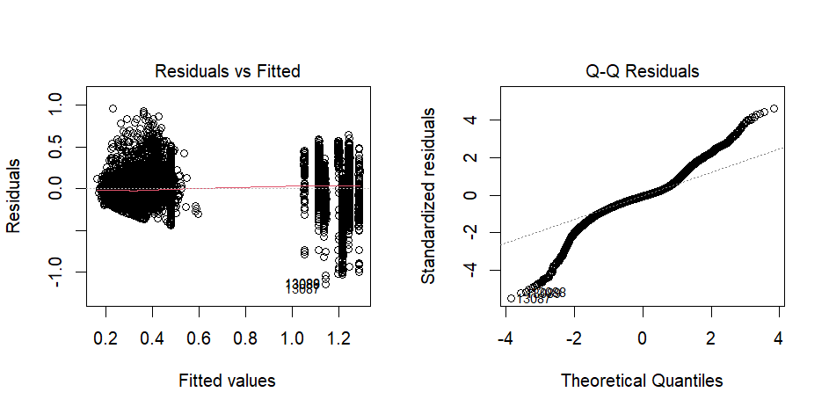
Linear regression: PM2.5
Notes:
Left: clear clusters for smoking/non-smoking. Also clearly defined categories for smoking, as outdoor variation has little impact on indoor.
Right: non-normal residuals... Non-linear relationship? Noise in data
Improvements:
Consider number of cigarettes per day (e.g. identify by peaks in time series data)
Apply a threshold to remove noise and improve fit at higher concentrations
Further transformation to achieve normal residuals

Slide 39
Regional averages
Cornwall PM2.5 concentration is low compared to other UK regions
Explains low impact of outdoor on indoor

Slide 40
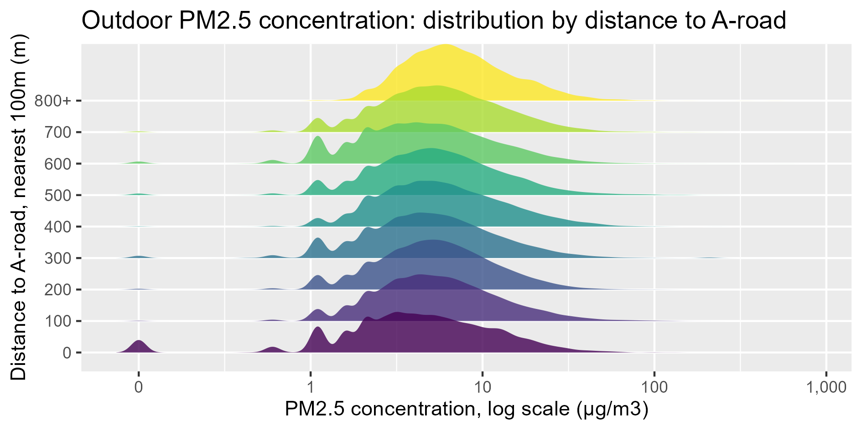
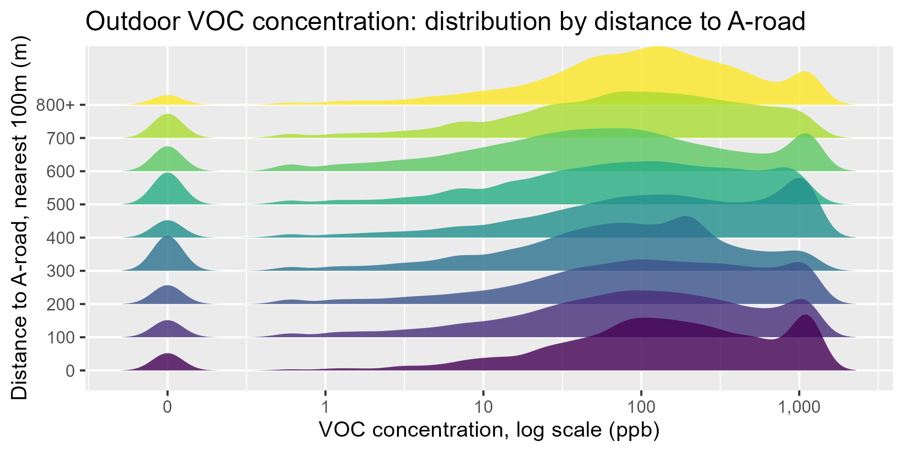
Impact of distance to A-road
Notes:
No clear impact of distance to A-road on outdoor PM2.5 or VOC
Expected more impact from PM2.5

